Slide 1
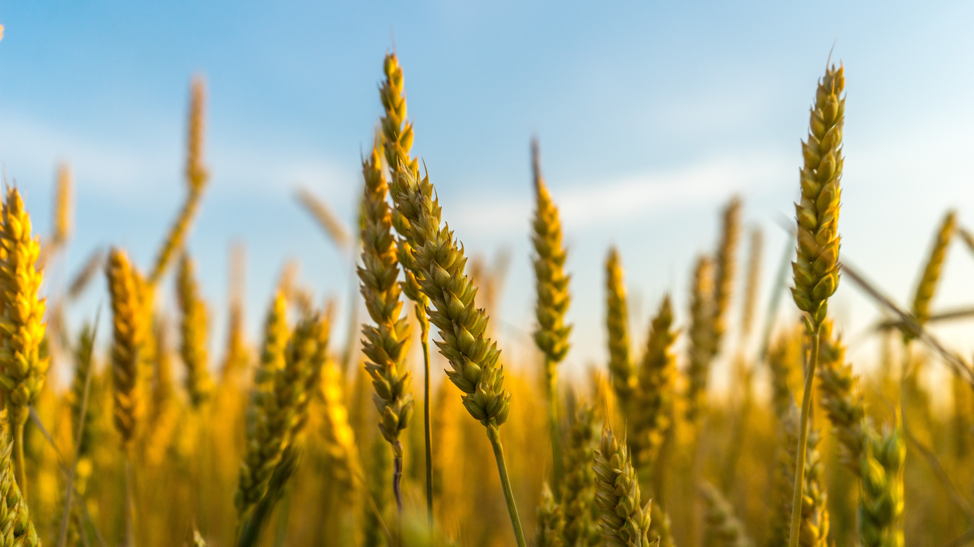
A CAPSTONE PROJECT
CROP PREDICTION

Slide 2
CONTENTS
Introduction
Procedure through Flow Chart
Problem Statement
Methodology
Key Finding
Key Architecture
Performance of Accuracy
How Helpful for Business
Conclusion

Slide 3
INTRODUCTION
Weather Forecasting and Predicting the amount of Rainfall that will occur in area can be very tedious.
For the Purpose of brevity the Method considers the factors whose effect is more prominent on the amount of effective rainfall.
The soil Moisture and pH Values are considered for suitable crop cultivation.

Slide 4
PROCEDURE THROUGH FLOW CHART
Temperature
Humidity
Machine Learning
Crop
Soil Moisture
pH Value

Slide 5
PROBLEM STATEMENT
The objective of our study is to provide a solution for Smart Agriculture by monitoring field which can assist the farmers in increasing productivity to a great extent.
By taking the essential parameters I will predict which crop is suitable in a particular condition.
The proposed system applies Machine Learning and prediction algorithm like linear support vector classification.

Slide 6
METHODOLOGY
Proceed with reading the data and perform data analysis.
The practice of examining data using analytical or statistical methods in order to identify meaningful information is known as data analysis.
After data analysis, we will find out the data distribution and data types.
Will train 3 classification algorithms to predict and compare the output.

Slide 7
KEY FINDING
Predict crop based on Rainfall, Temperature, Humidity and Soil Moisture.
Dataset is Pre-Processed and converted to numerals before training and prediction.
There are three techniques applied for prediction.

Slide 8
KEY ARCHITECTURE
SVM
Data Set
Training Set
Regression
Learn Model
Test Set
Model
Test Model
Predicted Crop
Suggest Fertilizer

Slide 9
PERFORMANCE OF ACCURACY
Model Name | Accuracy
K Neighbors Classifier | 0.97
Decision Tree Classifier | 1.0
Linear SVC | 0.74

Slide 10
HOW HELPFUL FOR BUSINESS
It helps farmers make informed decisions about their crops.
It involves estimate the number of crops that will be produced in a given area based on various factors such as soil type, weather conditions, and crop management practices.
It can be used to select the most excellent crops for the region and also its yield thereby improving the values and gain of farming also.

Slide 11
CONCLUSION
Out of all the Algorithms K Nearest Neighbour Classifier has performed good.
Entered the predicted test values into the competition Learning:
Predict “LABEL” all of the models the most accurate classification method is K Nearest Neighbour with Accuracy 0.97

Slide 12
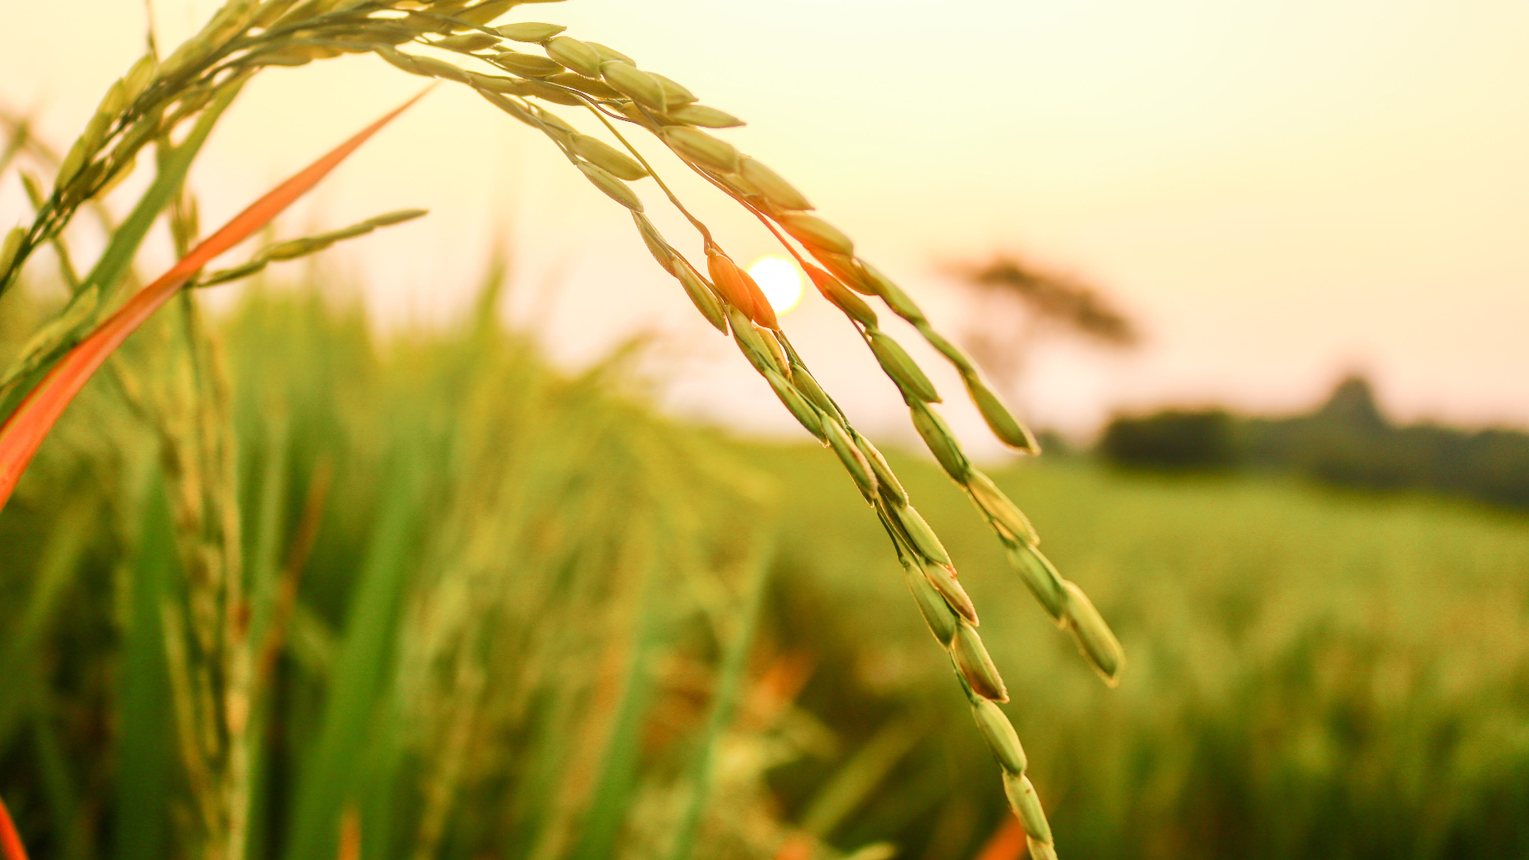
THANK YOU
DEEPESH B
deepeshnani1999@gmail.com
PGA 26

